Slide 1

1
ECTE250
ENGINEERING
DESIGN
AND
MANAGEMENT
2
Winter 2025 / Spring 2025
Engineering Design and Prototyping

Slide 2
Engineering Design & Prototyping

Slide 3

Introduction to Prototype Design
◻ In ECTE250 we will spend a lot of time building
electrical prototype
a
◻ We need to illustrate how our design is meeting
requirements including using the minimum power
the
consumption
for
the
maximum
functionality
3

Slide 4
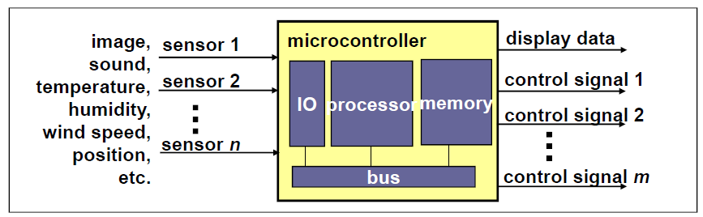
Definition of
a System
◻ A system is a set of components that interact to accomplish an objective.
◻ A system is a mapping of a set of inputs into a set of outputs
◻ Every real-world system.
entity,
either
synthetic
or
natural,
can be
modelled
as
a
4

Slide 5
Example: Simplicity
◻ Simplest design is a blank empty box
electrical components!
◻ It uses the minimum POWER (nothing!)
◻ Hence it satisfies the Minimum power
constraint/criteria
◻ But it provides no useful function
with
no
◻ It does not meet the functionality
will get zero marks!)
(and
if proposed
5

Slide 6
Example: Complexity
◻ A complex system of interconnected relays, resistors,
capacitors, Integrated Circuits (ICs), motors and
sensors, and microcontrollers
◻ Can provide maximum functionality
◻ Will use an inordinate amount of power and hence
cost more
◻ However, could be justified if the functionality is
MANDATORY for proposed design
6

Slide 7
Trade-off
◻ So often in engineering design we need to have a trade-off
◻ Hence you should always talk to a client, their needs (must
have), would like, and what they can afford
◻ In ECTE250 we have
a limited physical budget (900 AED)
and
we have to
prototype
keep
the
system
cost
around
this price
for
the
7

Slide 8
Trade-off
◻ In industry your budgets will be larger but you cannot start
ordering until management approves ALL expenses including
YOUR COST OF LABOUR!
◉ In fact the organization you work for will often have fixed costs that need to be allocated
including (hopefully) your wage.
◉ So when budgeting for a project ensure that you cover your wages as per the schedule of
costs used by your organization.
◉ In ECTE250 these costs are outlined in the Project Information Booklet.
◉ You should use these numbers when estimating project Labour costs.
8

Slide 9
Introduction to Prototyping
◻ Your prototype should reflect / or scale to the
device
final
◉
Often called PROOF OF CONCEPT PROTOTYPE
◻ In
◉
ECTE250 a small scale prototype of the real system
E.g. we won’t be using actual traffic lights but will build a
model of these
But the functionality should scale to a real set of traffic
◉
◻ So the prototype that we design in ECTE250 is a model
of a much larger system
9

Slide 10
Building the Prototype
◻ In ECT Engineering and related areas we build our
prototypes using electrical devices (hardware and/or
software).
◻ However before you build a prototype device you will
need to use these electronic components and validate a
design of the prototype (starting with a model, such
block diagram design)
as
◻ This is usually followed by simulations (of electronic
circuits, software algorithms) or emulations.
10

Slide 11
Building the Prototype
◻ Then actually building it on a ‘breadboard’
◻ And then actually building it on a ‘perfoboard’
◻ If these all work you may then decide to get it
massed produced in a factory (we never go this with our university projects due to the cost! Even
far
though economies of scale indicate the cost per unit
goes down)
11

Slide 12
Building the Prototype
◻ Our prototypes are not (usually) specified in terms
of how much pressure they need to endure or how much the temperature is but rather does it achieve
the electrical functionality required by
the device.
◻ Hence we do
not
really
need
to
worry
about
these
other
factors.
12

Slide 13
Introduction to Prototypes
In
◻
summary, electrical prototypes are:
Proof of concept
◻
Don’t have to be a
to-scale replica of machine
◻
Sometimes can be one-off projects (that’s the nature
of project work) sometimes are mass produced
◻
Prototypes can incorporate various electrical
sensors/actuators or emulation of these
13

Slide 14
Preliminary Design
◻ Design involves also refining
need, or can afford.
customer’s wants, or
◻ Investigating that the system
to be developed is
feasible (can we get the building blocks of the
system together
and sustainable
at reasonable price for the client)
and ethical
◻ Then once these
are achievable a preliminary
design is required (Deliverable 1)
14

Slide 15
Preliminary Design
◻ In ECTE-based disciplines we use either block
diagrams or state diagrams or flow charts (or
UML, DFD, etc…)
◉ Ensure that the semantic is consistent
◻ Block diagrams are usually preferred for the
bare-bones electrical design
◉ use state diagrams for software or flip-flop state machine design (ECTE233)
◉ use flowchart for overall functionality, though the first
stage of this should have a block diagram!)
15

Slide 16
Block Diagrams
◻ Composed of Blocks
◻ Arrows indicate interconnected
signals or power
◻ Inside each block is a statement of purpose and some
indication of how it is composed
◉ e.g. operational amplifier circuit or composed of transistors or
Integrated Circuits etc…
◻ Its simple and shows all the main hardware components
required to build the electrical system.
◉ It can be used also for software (not to specify functionality)
16

Slide 17
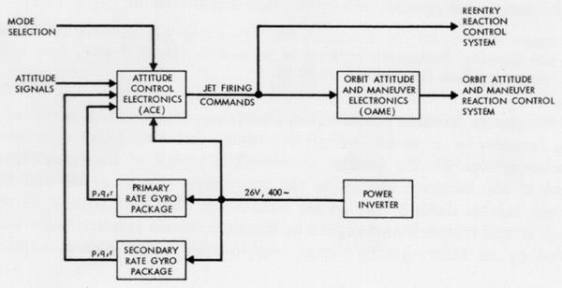
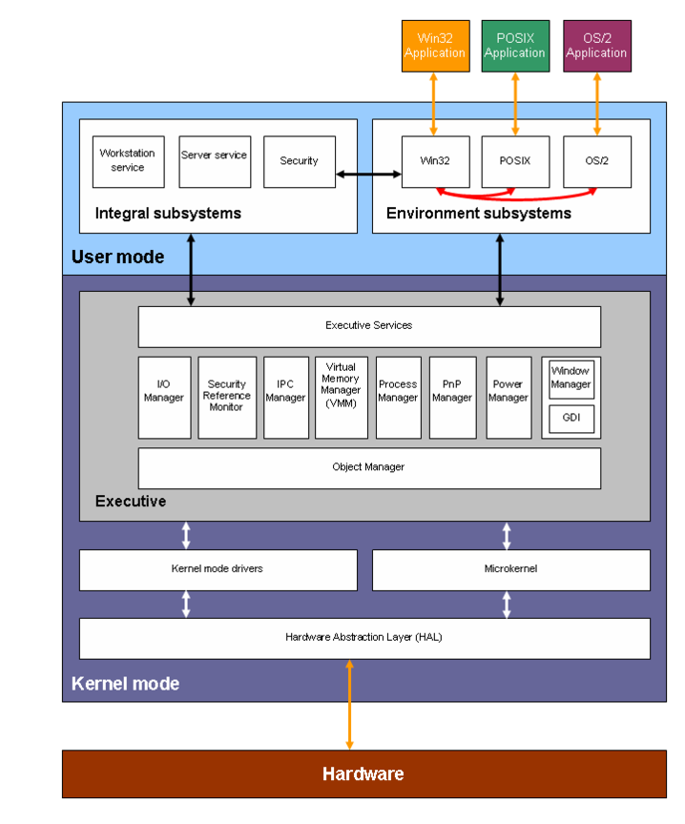
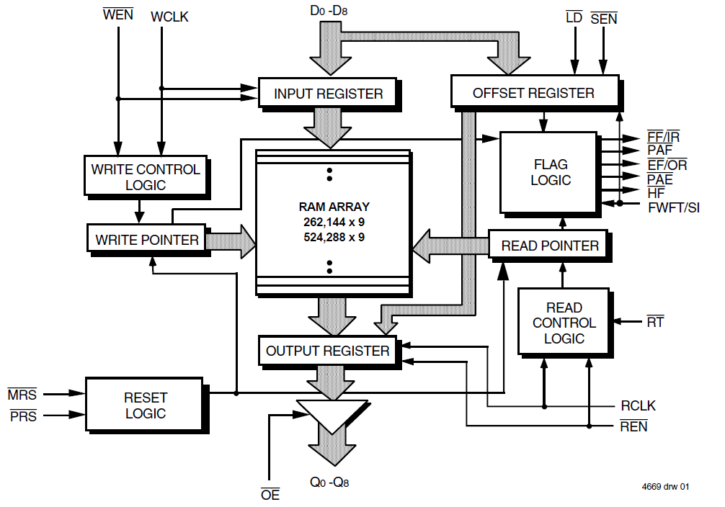
Block
Diagram
Examples
17

Slide 18
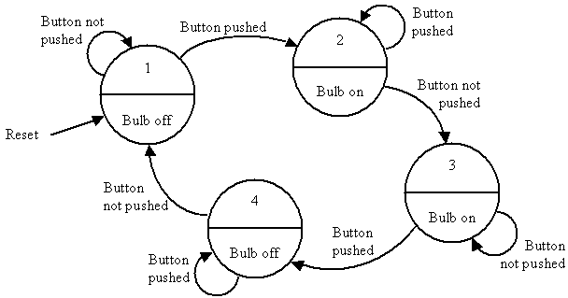
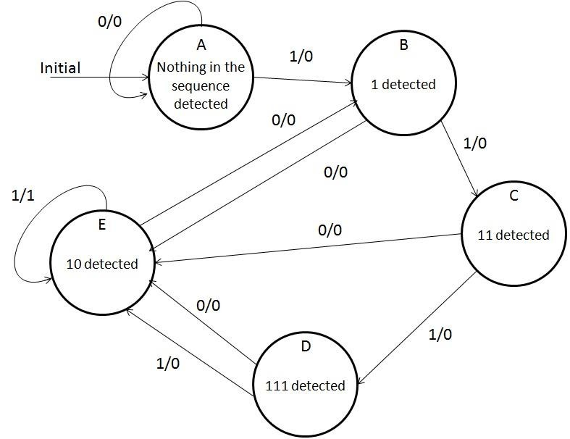
State
Chart
Examples
18

Slide 19
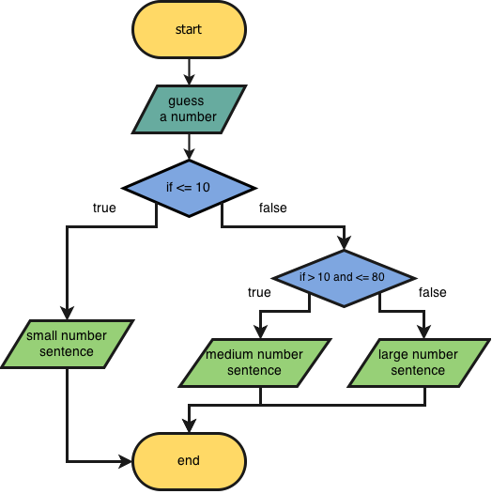
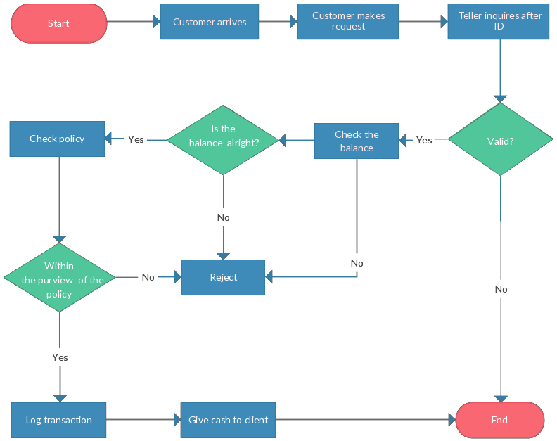
Flow
Chart
Examples
19

Slide 20
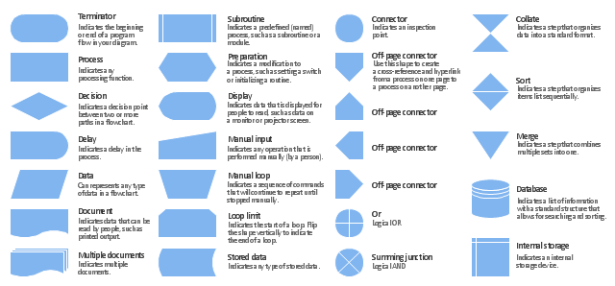
Flow
Chart
Example
20

Slide 21
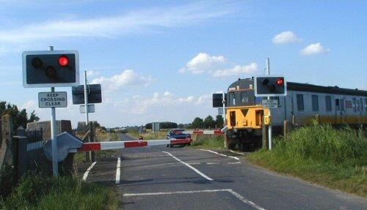
Block Diagram Detailed Example
◻ So now lets start a simple block diagram similar to the one for your project
(a railway crossing)
◻ First draw the main components
◻ Best to identify in a list (not comprehensive):
◉
◉
DC motor or permanent magnet motor coupled to a railway crossing post
State machine controlling signalling for road way intersection and then the same or another (your design choice considering you should use minimal power) to control the railway crossing
Devices such as LEDs to be traffic lights and light alternating devices
Need signals to indicate the need for change (these are our temperature sensors,
tilt sensors or debounced pushbuttons)
Need a timer to indicate cycle start and end, provide clock to state machine and
hence may need more than one plus need a ‘heartbeat’ generating timing circuit
Need a ARDUINO to do monitoring functions (Network and LCD Display)
Need and ADC to convert sensor signals
Need a power supply to drive all the above!
◉
◉
◉
◉
◉
◉
21

Slide 22
Preliminary Block Diagram Development
◻ Use a drawing tool (e.g. MS Power
or draw by hand).
Point,
MS
Visio,
◻ First
Block
is
the
Power
Supply
Power Supply – using Voltage
Regulator and 150mA Dual Supply
22

Slide 23
Preliminary Block Diagram Development
◻ Next
Block
is
the
Arduino
and
Breadboard
and LCD
Display
Power Supply – using Voltage
Regulator and 150mA Dual Supply
Arduino & Breadboard * LCD
Display
23

Slide 24
Preliminary Block Diagram Development
◻ Since Arduino and LCD are powered via USB we wont connect these to the power supply
Power Supply – using Voltage
Regulator and 150mA Dual Supply
Arduino & Breadboard * LCD
Display
24

Slide 25
Preliminary Block Diagram
Development
◻ Next Block is the state machine(s)
State machine(s): Determine
Control of railway intersection
And road intersection (one or two
state machines required)
Power Supply – using Voltage
Regulator and 150mA Dual Supply
Arduino & Breadboard * LCD
Display
25

Slide 26
Preliminary Block Diagram
Development
◻ Next Block is the motor and motor control for
railway crossing:
State machine(s): Determine
Control of railway intersection
And road intersection (one or two
state machines required)
Power Supply – using Voltage
Regulator and 150mA Dual Supply
Motor and Motor control: Uses
a H-bridge (in kit) to control a
railway crossing intersection
Arduino & Breadboard * LCD
Display
26

Slide 27
Preliminary Block Diagram Development
◻ Next add some power and control signals
(numbers are for you to specify how many lines)
◻ Use text or color-coded connection to describe
type and amount of signals
◻ Also note that if there are no signals or power
lines in a given direction there is no need to enter it into the block diagram!
27

Slide 28
Preliminary Block Diagram
Development
State machine(s): Determine
Control of railway intersection
And road intersection (one or two
state machines required)
?
Power Supply – using Voltage
Regulator and 150mA Dual Supply
?
?
?
?
?
Motor and Motor control: Uses a
H-bridge (in kit) to control a
railway crossing intersection
Arduino & Breadboard * LCD
Display
?
28

Slide 29
Preliminary
Block
Diagram Development
Analog Temperature
sensor
?
◻
May want to add a temperature sensor
and a Analog to Digital converter into the
mix (descriptions removed
blocks)
to
reduce
size
of
1
State machine(s):
?
?
Power Supply
Analog to Digital
operational amplifier
circuit
?
?
?
?
?
Arduino &
Display
Motor and Motor
control:
4
Breadboard * LCD
?
29

Slide 30
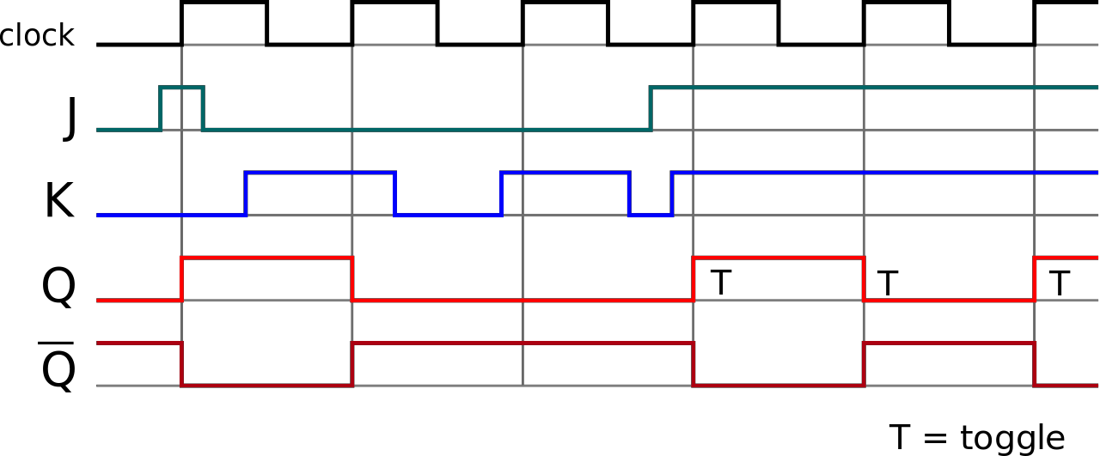
Preliminary Block Diagram Development
◻ There are still other components you must include such as the
heart beat circuit, the timing/clocking circuits
◻ After the block diagram of your system is done you will need
to
develop a timing diagram for your
system regulated by your
state
machine
(it
may
be
combined
with
Arduino
subsystem)
30

Slide 31
Preliminary Block Diagram Development
◻ In S2-W3 presentations we expect that the proposals
are detailed at least for the state machines
◻ Other block such as timers, voltage regulators circuits,
ADC, op-amp circuits and debouncing circuits can be
represented with simple blocks (these will be briefly
introduced next week, and discussed in details S2-
W1to4, you can do some research and present some
of these if you wish).
31

Slide 32
Preliminary Block Diagram Development
◻ Block diagrams are
intend to produce a
electrical hardware
useful: you can specify how you
certain functionalities while hiding
or design detail design
◻ More details are required in Deliverable 2
and Deliverable 6 (full)
◉ remember its 6 hours per week per person so
sub-modules in your team quickly!)
(partial)
delegate
32

Slide 33
The Design Process
◻ What do we do after forming a preliminary
design?
◻ We have to go through the design process
◻ This is iterative by nature (especially in electrical engineering).
◻ The whole of ECTE250 project should be an iterative
design
process, some teams may find they need to change their designs at a much later stage than is expected
◉ this is part of project design, though the later a design is changed the greater its cost, this is the reason for electronic simulation of electrical circuits
33

Slide 34
Definition
Engineering design
is the process of devising (i.e. inventing, creating) a
system,
needs.
component,
or
process
to
meet
process
desired
(often
It
is a
decision-making
iterative),
in
which
the
basic
sciences,
mathematics,
and
engineering
sciences
are
applied
to
convert
resources
optimally to meet a stated
objective.
34

Slide 35
Engineering Design Processes
What is a design process?
Among the fundamental elements of the design process are the establishment of objectives and
criteria, analysis,
synthesis,
construction,
testing,
and
evaluation.
35

Slide 36
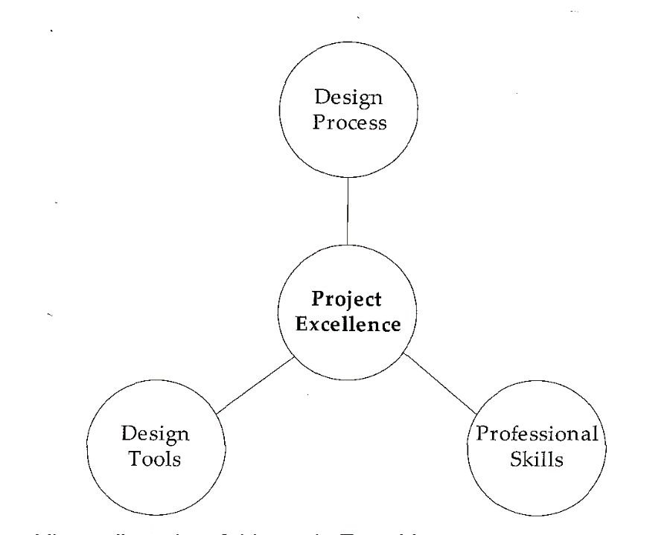
Engineering Design
Processes
◻ To achieve success in executing
engineering and design projects, it takes an understanding of the design
process, strong knowledge of
design
tools,
and
professional
skills.
Success of Product:
Yesterday → Competing Cost
Today → Quality
Tomorrow → Design
36

Slide 37
Engineering
◻ Engineer: One versed (i.e. expert/skilled) in the
design, construction, and use of machines
◻ Engineers use methodical application of scientific
knowledge and technology
◉ Math, Sciences and Fundamental
Technologies
Innovation + Methodical Application of Science
Effective Engineering/Design
◻ i.e., we are not improvising, or trying our luck!
37

Slide 38
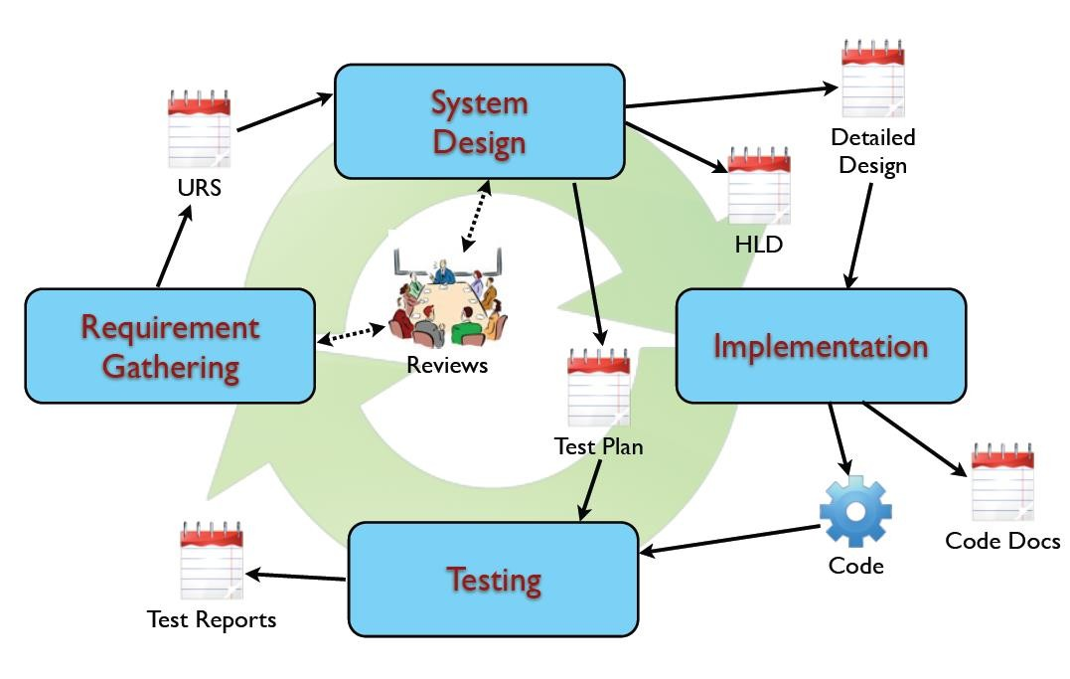
Design
Process
38

Slide 39
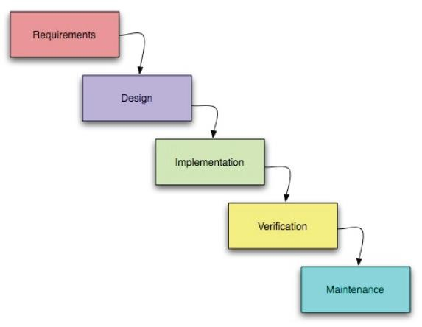
Waterfall
Model
39

Slide 40
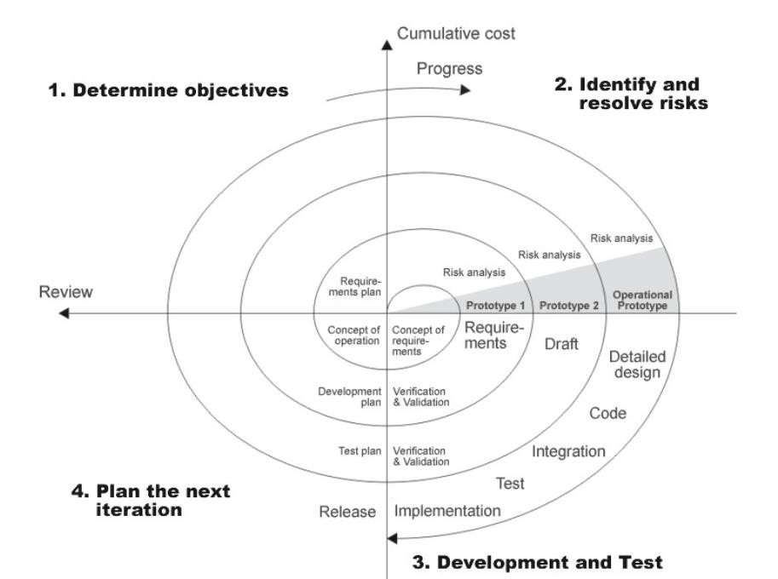
Spiral
Model
40

Slide 41
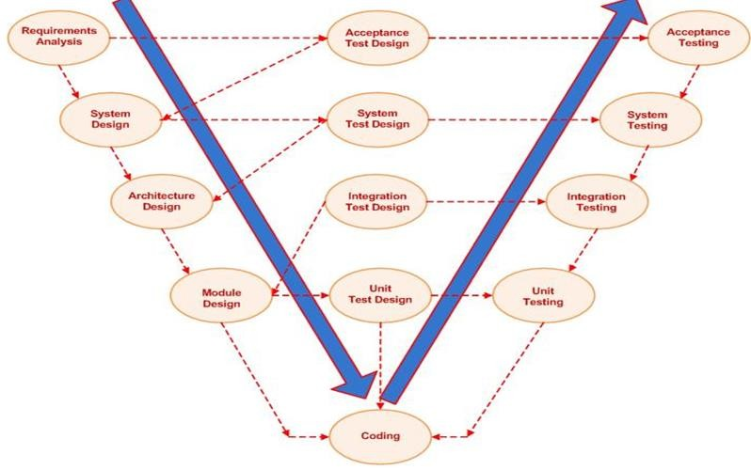
V-Model
41

Slide 42
Design Process
◻ Source: Engineering Design: A project based Introduction,
edition C.L.Dym and P. Little, Wiley
◉ Handout available on Moodle
3rd
◻ Given the Requirements/Specifications/Constraints, the simplest
descriptive model of the design process defines 3 phases:
1.
2.
Generation: the designer generates or creates various design concepts
Evaluation: the designer tests the chosen design against metrics that reflect client’s objectives and against requirements that stipulate how the design must function
Communication: the designer communicates the final design to the client
and to the manufacturer or fabricator (in this case that’s your team)
3.
42

Slide 43
Design Process
A more appropriate model
not complex enough is:
for
electrical
engineering
while
still
Client’s Problem statement: We
want road and rail intersection
Electrical designs!
43

Slide 44
Design Process
Client’s Problem statement: We
want road and rail intersection
Electrical designs!
Problem Definition: How can the
team satisfy / brain storm
solutions for client’s problem using
available resources and state of
the art electrical technology
44

Slide 45
Design Process
Client’s Problem statement: We
want road and rail intersection
Electrical designs!
Problem Definition: How can the
team satisfy / brain storm
solutions for client’s problem
using available resources and
state of the art technology
(usually done inside the project
team)
Conceptual Design: Looking at the
available options / solutions within
the team what is the best bare bones
design to provide the client justified
on the design constraints and criteria
/ functionality! You can consult with
client to clarify ideas and criteria
45

Slide 46
Design
Process
Preliminary Design: from the chosen
conceptual design we start putting
some major detail into the design. Not
everything is accurately described,
but most elements of the designed
system are highlighted in terms of the
building blocks needed to produce
the final product. This is presented in
Deliverable 1
46

Slide 47
Design
Process
Preliminary Design: from the chosen
conceptual design we start putting
some major detail into the design. Not
everything is accurately described,
but most elements of the designed
system are highlighted in terms of the
building blocks needed to produce
the final product
Preliminary Design: from the chosen
conceptual design we start putting
some major detail into the design. Not
everything is accurately described,
but most elements of the designed
system are highlighted in terms of the
building blocks needed to produce
the final product. This is presented in
Deliverable 1.
Detailed Design Part 1: from the
preliminary design we form nearly all
if not all of the major and minor
detail into the design. Virtually
everything is now accurately
described, allowing the production of
comprehensive design documents such
as electrical schematics, and pseudo
code or flow charts for software
documentation. This is presented in
Deliverable 2.
47

Slide 48
Design
Process
Detailed Design Part 2: Here the
system is tested and validated using
electronic simulation, testing on
breadboard using electronic
measurement tools such as multimeter
and oscilloscope and sinusoidal test
sources if appropriate (oscillator),
then building and testing on
perfoboard then writing final report
and providing final schematics
(deliverable 3, 4, 5 & 6) and
production information as well as any
technical details for marketing
purposes (deliverable 7 & 8). This
should also include progress reports
to the client and tutors / employers
(ongoing on moodle).
48

Slide 49
Design
Process
Design Communication: This is the
wrap up of the project and handover
of all design and commissioning
documents and maintenance manuals
to the client, all of which are usually
agreed to in a scope of work legal
document at the start of the project
when approved. These are all
important but the final written report
covers most of these in ecte250
(deliverable 6). It can include
fabrication specifications if the design
was a product such as a small FM
radio
Client’s gets product prototype
and possibly (if agreed)
Documentation for Final Design
composed of Report, Schematic
Drawings and Mechanical
Drawings, Fabrication
specifications etc..
49

Slide 50
Design Process
Client’s Problem statement: We
want road and rail intersection
Electrical designs!
Problem Definition
Conceptual Design
Preliminary Design
Detailed Design Part 1
Detailed Design Part 2
Deliver Client’s product and
documentation agreed to!
Design Communications
50

Slide 51
Design Process is Iterative
◻ When designing testing is ESSENTIAL
◉ you have to design validation TESTs as well
◻  Its during testing that design issues that were not foreseen illustrated and rectified
◉ and you should allocate time for identifying and fixing issues
can be
◻  The detailed design phases in part 1 and 2 may include re- designed components after testing
◻  However we should also refer back to the earlier design stages simply to ensure that we are conforming with the project requirements when making changes to the design that was agreed to with the client in the early stages of the project.
51

Slide 52
Design Process
is
Iterative
Client’s Problem statement: We
want traffic and rail intersection
Electrical designs!
Problem Definition
Conceptual Design
Adding iteration
(refining design
due
to
testing)
Preliminary Design
Validation / building / testing / debugging /
revising design
Detailed Design Part 1
Detailed Design Part 2
Deliver Client’s product and
documentation agreed to!
Design Communications
52

Slide 53
Cost to Implement
Changes
Cost to
implement
changes
Project lifetime
53

Slide 54
Design Process is Iterative
◻
In an electrical project where power is a desired constraint, team might realise they can perform the same functionality using only one flip flop chip rather than four! Hence less power needed, even though the original design had four chips this can be refined and product costs reduced
◻
Or a sensor is deemed redundant due to a change in scope agreed to by your mentor (which does not change the required specification of having at least one analog to digital op-amp circuit) then this could be agreed and a design change implemented between the breadboard and perfoboard stages of the electrical project
◻
Or your original design needed 3.3 Volt supply needing a regulator but during testing phase a team member realises that this can be achieved only using 5 volt supply with only a small increase in power requirement but a significant decrease in overall product cost
◻
Or there was a complete design fault that the team was not aware of and was not detected by the tutor or laboratory demonstrators but became evident when the product was bread boarded
◻
This is the process of electrical design where costs at the testing phase are still not too large as to prohibit changing the design accordingly in the light of new found knowledge
54

Slide 55
Design Considerations
1) WORST CASE DESIGN
➢ Component variation
➢ Environmental conditions
➢ Use
computer
simulations
55

Slide 56
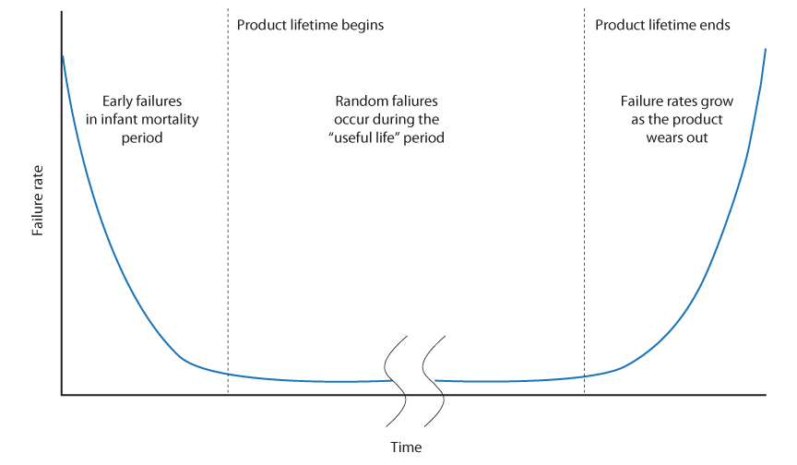
Design Considerations
2) RELIABILITY
➢  measured by MTBF (mean time between failures)
➢ failure rate = 1/MTBF
➢ mechanical parts fail first
➢ design redundancy into
system
➢ simple system/fewer parts =
more reliable
56

Slide 57
Design
Considerations
3) SAFETY
➢ identify
➢ provide
failure modes
protection
(Fail
Safe
or
Fail
Tolerant)
4) TEST
➢ design for ease of
test
5) PRODUCTION/MANUFACTURING
➢ consider ease of assembly
57

Slide 58
Design Methodologies
TOP-DOWN
➢ Also called “functional decomposition“
➢ implementation details considered only
lowest level
at the
➢ top-down design, is not so clean and linear in
practice
➢ often implementation-level
at high levels in the design
commitments are made
process
58

Slide 59
Design Methodologies
CASE-BASED:
➢ Research a specific, similar design case study
➢ Model your process on that
INCREMENTAL REDESIGN:
➢ Find an existing design and "unravel" the design from the bottom up
➢ Modify as required
➢  Detailed and least global aspects of the design are explored and redesigned, if necessary, first
59

Slide 60
Design Methodologies
ITERATIVE REFINEMENT:
➢ An iterative top-down approach
➢ First a rough, approximate and general
completed
design is
➢ Then we do it finer, more exact and more specific
➢ This process continues
detail design in done
iteratively
until
the
complete
60

Slide 61
Design Methodologies
BOTTOM-UP DESIGN:
➢ Opposite of top-down
➢ Start at the bottom with detail design
➢ To do this, you must have some idea of where you becomes...
are going.
So, often
this
HYBRID DESIGN:
➢ Combines aspects of both top-down and bottom-up
➢ More practical design approach then pure top-down
➢ Start with a top-down approach, but have feedback from the bottom
61

Slide 62
Design Methodologies
"EXPLORER" METHOD:
➢  Typically used for new design ideas or research. It is useful in initial design and specification stages, and is often used when in "unfamiliar territory":
1) Move in some direction; e.g. toward the library, telephone, domain expert's office, etc.
2) Look at what you find there.
3) Record what you find in your notebook.
4) Analyze findings in terms of where you want to be.
5) Use results of analysis to choose next direction.
6) Back to 1) and continue exploring
62

Slide 63
Requirements, Constraints, Specifications
◻ Requirement
◉ is a singular documented physical or functional need that a particular design, product or process aims to satisfy
◉ It can be physical/technical or functional.
■ Example 1: The LCD screen is activated by a switch (functional)
■ Example 2: They system must use one temperature sensor (technical)
◉ Requirements are important inputs into the verification process (verify
your system against required functionalities).
◉ In your ECTE250 project you have been provided with a list of (mostly)
technical requirements, you fill define the functional requirements.
63

Slide 64
Requirements, Constraints, Specifications
◻ Constraint
◉ refers to a limitation on the requirements and/or operation
conditions
under which a system is expected to operate.
◉ a design constraint can affect many features of a system.
■ Example 1: you can use at most 3 flip flops
■ Example 2: you must use the TMP32 for the temperature sensor
◉ In your ECTE250 project you have been provided with a
list
of
(mostly)
technical
requirements which include constraints as
well.
64

Slide 65
Requirements, Constraints, Specifications
◻ Specification
◉ is a quantitative, measurable criteria that the product satisfy.
◉ Specifications may be result (direct or indirect) of a requirement.
◉ Specifications are not a list of functionalities.
■ Example 1: the weight of the product is 200g
■ Example 2: the average power consumption is 2W (power analysis is a must)
■ Example 3: the power supply is +/- 15V (in ECTE250 projects this is a
consequence of
a requirement!)
65

Slide 66
Components for Block Design
◻ In
teams there are 5 design roles:
◉
State Machine Subsystem designer
Arduino Subsystem designer
Sensing and ADC Subsystem designer
Auxiliary Subsystem designer
Integration of State Machine Subsystem
◉
◉
◉
◉
with the
rest
66

Slide 67
Components for
Block Design
◻ This
does not imply that
your
block
design is something
like
this
State Machine
Sensor and ADC
Arduino
Everything Else
67

Slide 68
Power Supply
◻ Your system external supply is +15V/-15V/GND (Requirement
◻ Several sub circuits will definitely require +5V
8)
◻ Your
power
supply
system should look (at least)
like
this
+15V
-15V
+15V
GND
Power Supply
+5V
GND
-15V
68

Slide 69
Power Supply
◻
But you can design (if needed
something more complicated)
◉
Multiple output voltages
Dedicated output voltages with
◉
enable/disable
port
(save
power
using
relays!)
Enab. +15V
+15V
-15V
+5V
+3.3V
GND
+15V
GND
Power Supply
-15V
Enable
69

Slide 70
State Machine
◻ Requirement 1
◻ It requires power (likely 5V), and a clock signal.
◻ Arbitrary number of Input and output (TTL or CMOS levels, i.e. 0-5 V)
◉ Input from: Internet (via Arduino), Switches, Buttons, Timer, Sensors via ADC,
Sensors via Arduino, etc…
◉ Output to:
Internet (via Arduino), LCD (via Arduino), LEDs, Timer, etc…
X
State Machine
Y
Inputs
Outputs
+5V
GND
Clock
70

Slide 71
Clock Circuit
◻ It requires power (likely 5V),
(for the State Machine).
and
it
generates
a
clock
signal
◉ You
will
choose
the frequency
Clock
Circuit
Clock
+5V
GND
71

Slide 72
Input Circuits
◻ These circuits de-bounce push buttons and switches (Requirement 4)
◻ It requires power (likely 5V)
◻ It takes Z bouncy inputs and produces Z de-bounced outputs
◻ A switch or button can emulate a larger input device you do not have
◉ Example: sensor detecting if the weight applied to a plate is more or less than 1kg.
Z
Z
Inputs
Input Circuits
Outputs
+5V
GND
72

Slide 73
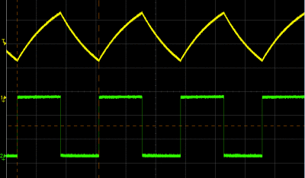
555 Timer Circuit
◻ It requires power (likely 5V), and it generates
a
periodic
signal
as
described
in Requirement 7
option 1.
555
Timer Circuit
Signal
+5V
GND
73

Slide 74
555 Timer Circuit
◻ Or it can fulfill another time-based purpose.
◻ Example, set an output to high
when the
seconds.
input
is
triggered and
clear
the
output to low after X
Trigger
555
Timer
Circuit
Output
+5V
GND
74

Slide 75
Sensor Circuit
◻ The analog sensor (in ECTE250) is a variable resistor (Requirement 2)
◻ The Sensor maps a physical quantity to a resistance value
◻ The Sensor circuit maps a resistance value to an analog value
◻  You must define the input range (physical quantity) and output range (voltage), then you can
design the circuit (ADC is likely 0 to 5, for both external and Arduino ADC).
◻ It may require multiple voltage (for sensor and for op-amps)
◻ You can use a potentiometer to emulate other sensors (which you do not have).
Sensor Circuit
Output
Voltage
to ADC
Sensor
-??V
+??V
+??V
GND
75

Slide 76
ADC
◻
The analog to digital converter (Requirement 2) converts an analog voltage (in a given range)
into a digital value with a given number of bits (also called resolution).
For the ADC you implement must have 4-bits resolution and you can define the input voltage
range (likely to match the output of your sensor circuit or vice versa).
The Arduino ADC has input range 0-5V and 10-bit resolution.
It is essential to define an expression to derive the physical quantity from the ADC output. The output (all lines, fewer, or a combination of these, are likely to go to State Machine or
Arduino).
◻
◻
◻
◻
Input
Voltage
(to be
converted,
likely from
sensor circuit
output)
4
ADC
Digitized
Output
+15V
+5V
GND
76

Slide 77
Motor Circuit
◻
This circuit is significantly different if using DC servo or DC
permanent magnet motor
(Requirement 3)
(i.g. optoisolator or H-bridge).
◻
PWM
input
from
Arduino,
direction (permanent
magnet
only)
PWM
from
Arduino
2 or
3
Motor
Circuit
To Motor
Direction
(DC
Perm.
Magn.
only)
+5V
GND
77

Slide 78
ADC
◻ LCD driven by Arduino (Requirement 6)
◻ It can be driven with 6 or less lines (with less lines you need a shift register).
?
From
Arduino
LCD
+5V
From Arduino
GND
From Arduino
78

Slide 79
Arduino + Ethernet
◻
It’s the bridge between State Machine & Internet, LCD (Requirement 5)
It is powered via USB. It provides power to LCD and (partially Motor Circuit)
It takes inputs from state machine, but it can also provide outputs to state machine
(e.g. when using internal ADC too).
It can take data from external ADC.
◻
◻
◻
◻
It’s a very flexible
and versatile unit (it
requires software).
More
Sensors
Internet Via
Ethernet
X
?
From State
Machine
Arduino
+
Ethernet
To LCD
To State
Machine
Y
5V and GND
(to LCD)
5V and GND
from USB
79

